Slide 1
Project#8
Freemium A/B Testing
Scope: This project’s scope is to help a B2B (business-to-business) SaaS (software-as-a-service) company analyze its recent A/B test for its explainer video. The company uses these videos to convince free users to start a premium trial.

Slide 2

Team members:
Nadir Syed – Lead Developer, sql, python. Exp 14 years.
Shahid Kizilbash – DBA/Data Engineer. Exp 14 years.
Kusay Rukieh – Data Analyst, Network engineer. Exp 20+ yrs
Rafiat Bello – Masters(Biology), pursuing applied science
Sajid Kharoundwala – BI & Data Analyst
Communication channels:
Whatsapp for notifications, meetup invites etc & Slack for knowledge & document sharing. Skype for meetings and screen share.

Slide 3

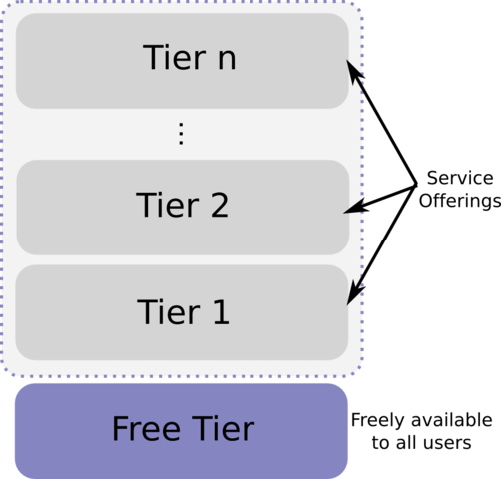
Background:
The term "freemium" refers to a service with two tiers:
Free tier that has only basic capabilities
Premium tier(s) that has the full set of features
“AB testing” is essentially an experiment where two or more variants of a page are shown to users at random, and statistical analysis is used to determine which variation performs better for a given conversion goal.

Slide 4
Challenges:
For B2B software, it can be trickier to convince free users to upgrade to premium plans due to a variety of reasons. Two of the most common are
Users may first need approval from a manager or budgeting department.
Users might not understand what the premium plan offers, especially if it introduces new services and features.
Freemium acquisition model helps with 2nd and reduce the cost required to acquire new customers by shifting the education burden from sales/marketing to the customer.
Recommended read:
https://blog.hubspot.com/service/freemium
https://www.optimizely.com/optimization-glossary/ab-testing/

Slide 5
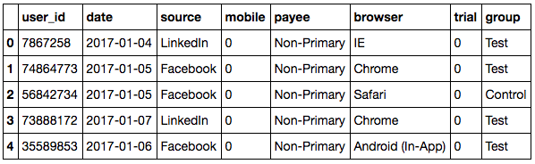
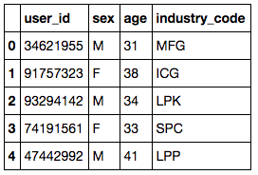
Data:
ab_trial_results
Control – Old Video Test – New Video
user_industry

Slide 6
Data Dictionary:
user_id - Unique ID for user
date - Date the user watched explainer video
source - Marketing channel user came from
mobile - Was user on a mobile device?
payee - Whether the user is the primary decision-maker for budgeting
browser - The user's browser
trial - Did the user convert, i.e. start a premium trial?
group - Group (test / control)

Slide 7
Objectives:
Determine which sources/devices/industries had the highest conversion rates.
Build a model that can predict conversion rate based on user data.
For high conversion rate users, what are the implications for the company's marketing team?
For low conversion rate users, what are the implications for the company's customer success teams?
Provide actionable insights to the business. What have we learned from this test?

Slide 8
Questions:
Define conversion rate?
Example: % users signup & convert in a day/week?
Quantify Conversion rate range?
Example: High: 25-30%, Low: 1- 5 %
Elaborate business problem? Analyze conversion rate of old explainer video & predict conversion rate of new video?
Use only old explainer video data or only new explainer video data or both?

Slide 9
Questions continued…
Kusay
1. Browser type is used for the transaction? 2. authority of the person who is trialing? 3. What device is used for trial period? 4. The channel which is used to get the software? 5. The date in which the user watch the tutorial video
Shahid
Is the company relying on source to create the explainer videos?
Can the videos be customized to properly convince free tier users?
What were the main differences between the old video and the new one?
What is the selection criteria for the control and test group?
Is the duration of membership important?
Rafiat
What device did the user use to view the video?
What percentage of current user sign up on mobile device after viewing the video?
What is percentage of signup with the old explainer video?
Is the old and new video all browser friendly?
Is there a particular browser with more signup?

Slide 10

Data Understanding
Exploratory data analysis (EDA) using R and Data Visualization using Tableau

Slide 11
Analytical Approach
Descriptive vs Predictive:
Predictive Analytics (predict conversion rate based on user data)
Descriptive Analysis (Come up with Actionable Insights)
Type of Learning:
Supervised Learning (Target variable ‘trial’ in Sample)
Type of Analysis:
Classification Analysis because: 1) Type of TV ‘trial’ is binary and 2) Type of business question predict conversion rate where Conversion rate = mean(trial)
Success Measures:
Confusion Matrix and/or PCC

Slide 12
Code Book
Data is structured, stored in flat files (.csv)
Data Structure: 346929 Observations of 11 variables.
Missing observations 350000 – 346929 = 3071
Data type of Target variable “trial” with value 0/1 is “int” instead of “factor”
Data Summary:
356 missing values of each feature “gender”, “age” & “industry_code”
9691 “Unknown” type of “payee”
Data Visualization:
Age (only numeric continuous input) is positive skewed = 0.74
TV “Trial” is imbalance 0 – 329,713 (94%) & 1 – 17216 (6%)

Slide 13
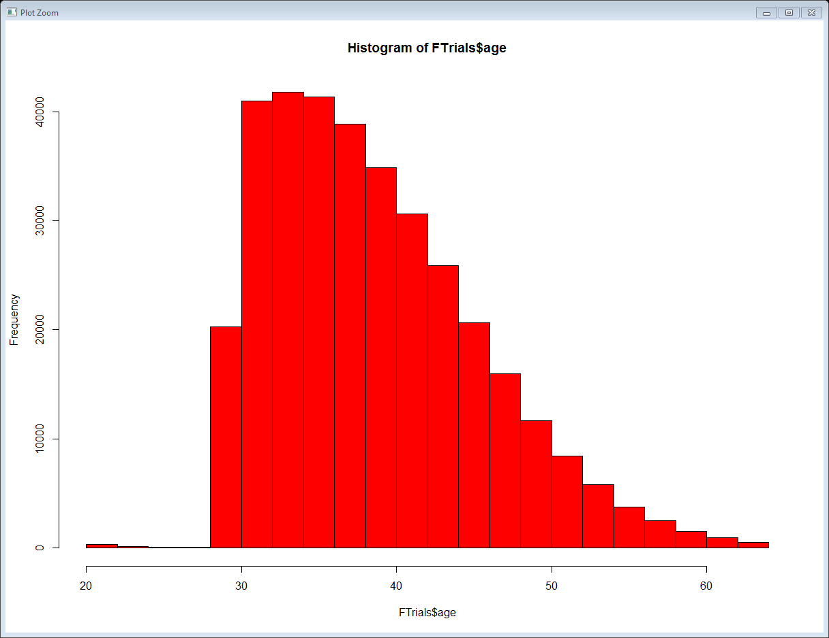
Data Visualization (Histogram)
Age is positive skewed (.74)
Outliers around Age of 21

Slide 14
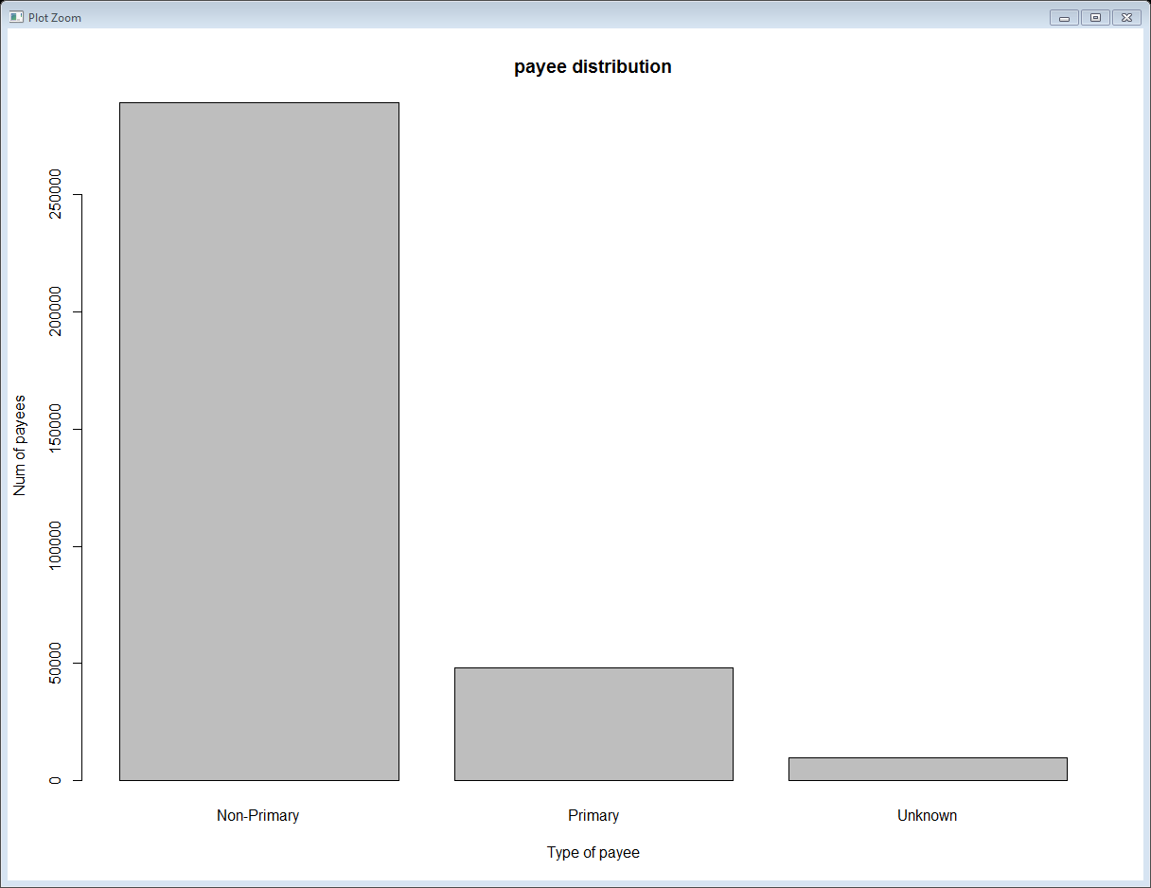
Data Visualization (Bar plot)
9691 “Unknown” type of “payee”

Slide 15
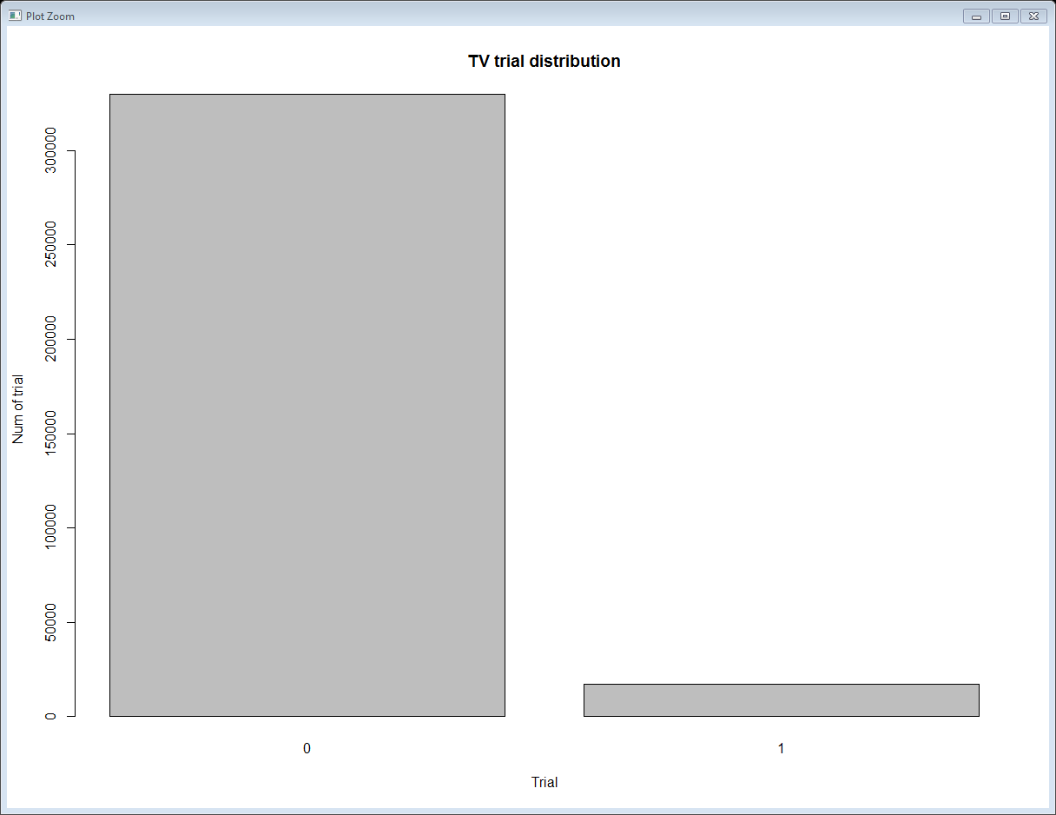
Data Visualization (Bar plot)
TV “trial” is imbalance 0 – 329,713 (96%) 1 – 17,216 (4%)

Slide 16
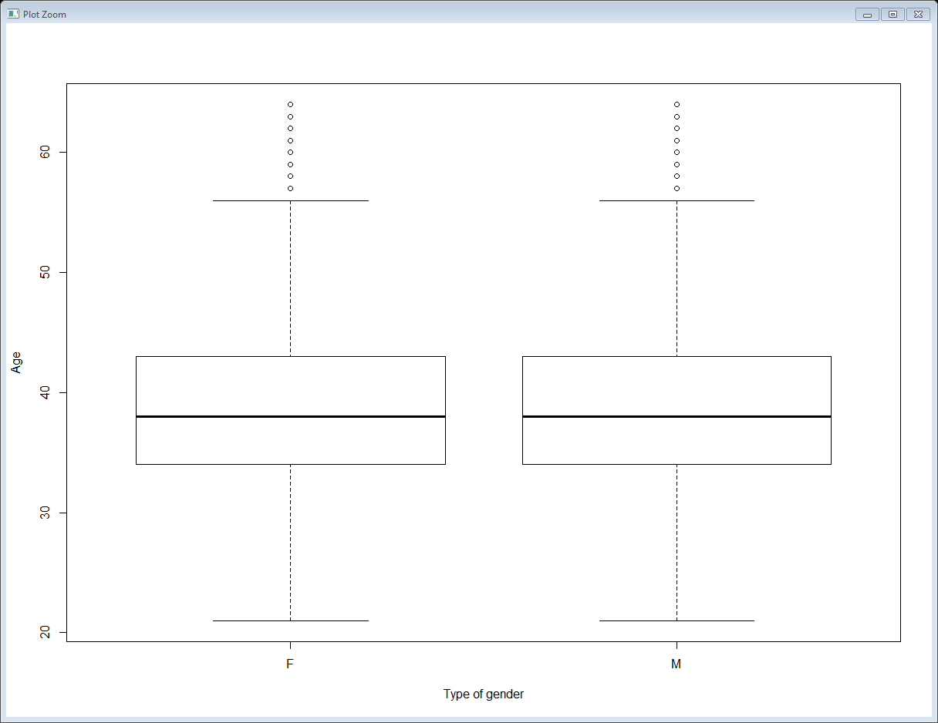
Data Visualization (Box plot)
Numeric Age vs categorical gender (M/F)

Slide 17
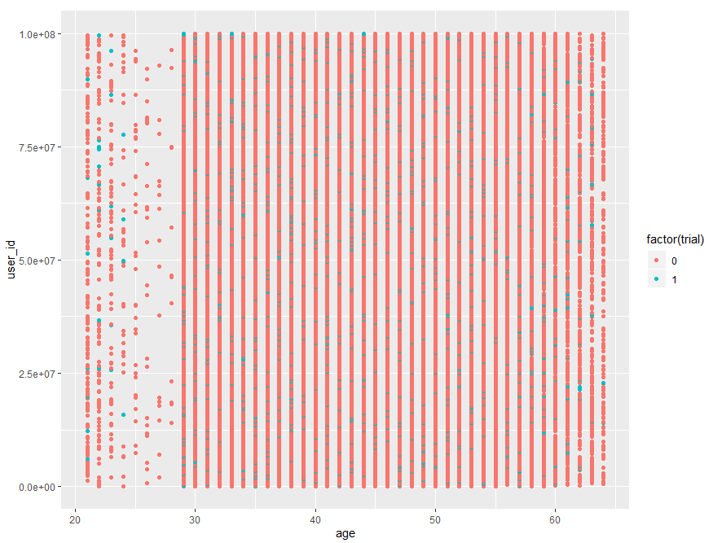
Data Visualization (Scatterplot)
Except Age, user_id all features are categorical and shows very low correlation. Highest corr = 0.023 (Industry) & -0.026 (group)
Data is NOT linearly separable

Slide 18
How to fix Data Quality Issues
Issue: 3071 Missing observations
Fix: Live with it, sufficient observations 346,929
Issue: Target variable type incorrect “int”
Fix: convert to factor in R using factor(trial, level = c(0,1))
Issue: 356 Missing values of “gender”, “age” & “industry_code”
Fix: Ignore observations with missing values, just 0.1 % of total observations
Issue: 9691 “Unknown” type of “payee”
Fix: No pattern, will use it as is - category
Issue: Age is positive skewed (0.74)
Fix: Use John Tukey ladder to get skewness close to 0
Issue: Imbalance binary Target Variable “trial”
Fix: Either use F1 score with imbalance data or balance the data with over/under sampling

Slide 19
Data Preparation & Modeling
Use R to prepare data and build models

Slide 20
Data preparation
Fix data quality issues identified in code book
Convert categorical features to Numeric
Mapping: like for Device 1-Mobile, 2-Desktop
Dummy variables: using dummies package, then sum(n-1) of dummy variables
Split data for each user group: Control (Old video) & Test (New video) to build separate classification models
Split data into training/testing set
Use caTools sample.split function to divide data into 80:20.
80% training set, 20% testing set

Slide 21
Select Model
First check data for model assumptions:
Input variables are related to TV (corr != 0) True
Input variables are normally distributed (Skewness=0/Histogram) False
All Input variables must be numeric (Map/Dummy) True
No missing values (complete.cases) True
TV is binary 0/1 True
Data is linearly separable (Scatter plot) False
So Decision Tree, K Nearest Neighbor, Logistic Regression, K-SVM

Slide 22
Modeling
Split data (Training/Test)
Scale data (Only Numerical Algo: K Nearest Neighbor, Logistic Regression & Kernel-Support Vector Machine)
Fit Model
Test Model (predict)
Assess and Evaluate Model
Accuracy, F1 Score (Precision, Recall) & Processing Time
Calculate Conversion rate = mean(ftrial)
Visualize Results (Decision Tree etc)

Slide 23
Tactics to deal Imbalance data
Recollect data if possible (may get more minority class observations)
Over Sampling (Increase minority to level of majority class)
Under Sampling (Take random samples of majority to match minority class)
Change Evaluation/Assessment Measure - ROCR/AUROC
Algorithms not sensitive to Imbalance data like DT, Ensemble methods (RF, Bagging, Boosting)

Slide 24
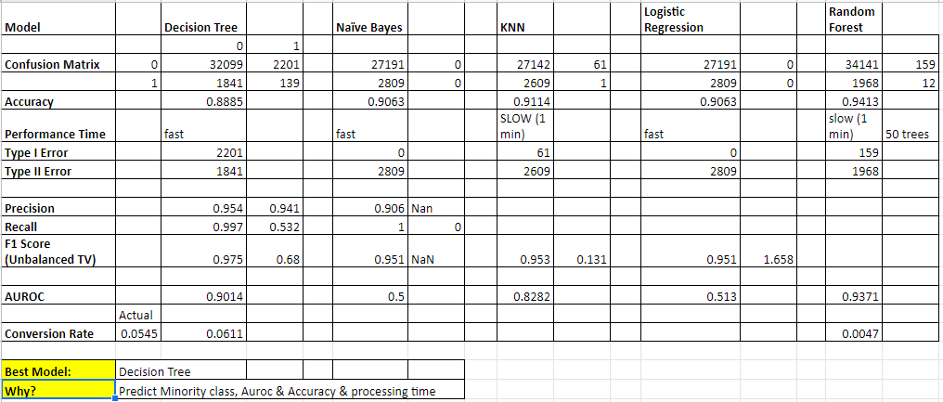
Model Comparison (Choose Best Model - Control)

Slide 25
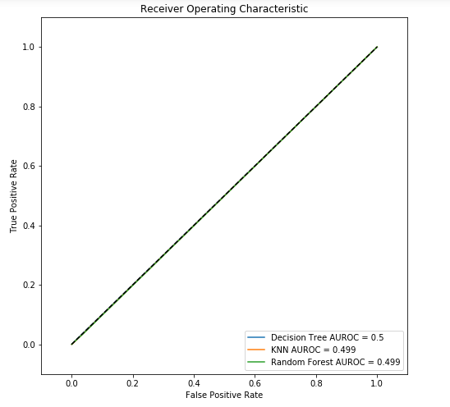
ROC curve - Model comparsion (Control)

Slide 26
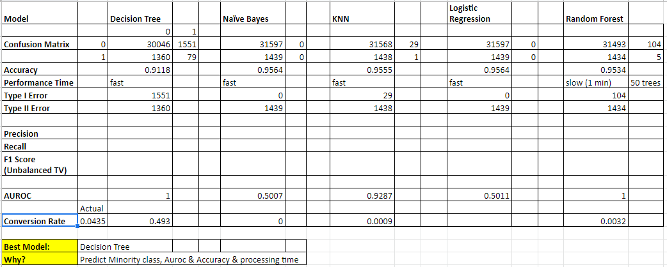
Model Comparison (Choose Best Model - Test)

Slide 27
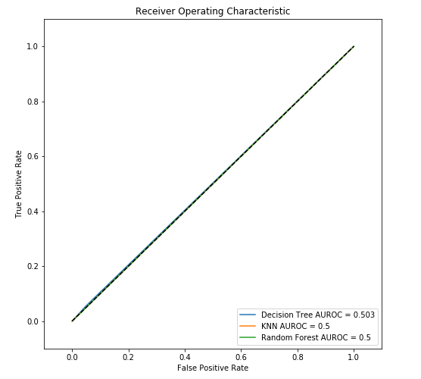
ROC curve - Model comparsion (Test)

Slide 28
Descriptive Analysis
Use Tableau & python to visualize data

Slide 29
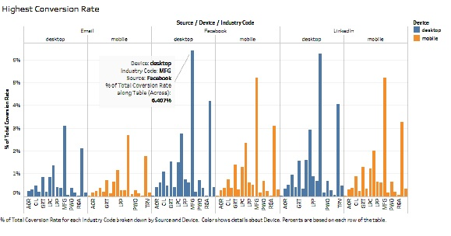
Determine which sources/devices/industries have the highest conversion rates

Slide 30
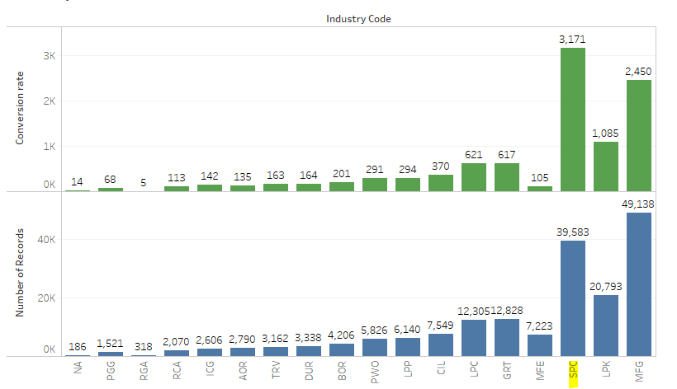
Conversion rate by Industry Code- for Control users

Slide 31
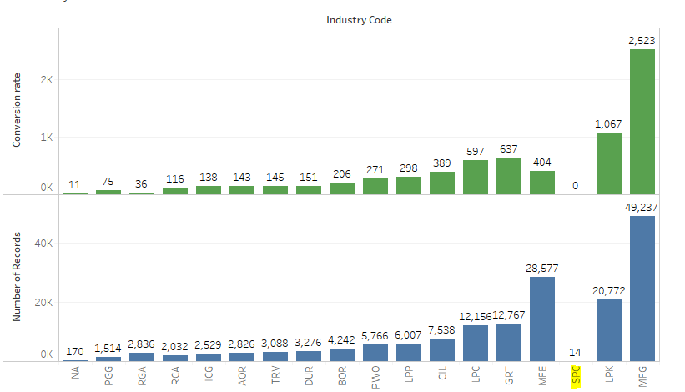
Conversion rate by Industry Code- for Test users

Slide 32
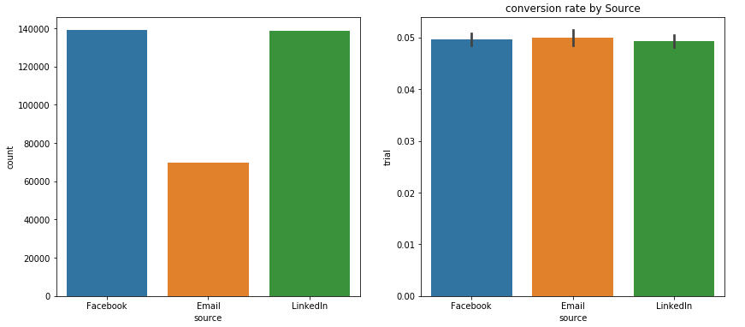
Conversation rate compared to source distribution: here we see that most visitors were coming from marketing channels: Facebook and Linkedin but when it comes to converting almost all three sources show a SAME rate of conversion.

Slide 33
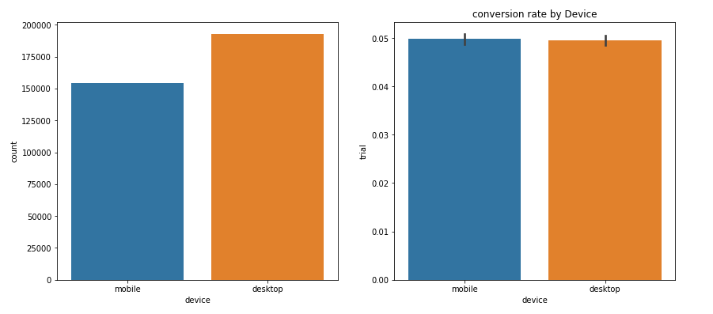
Conversion rate by Device: In this case we see the highest number of users are using desktop, close to 200,000 users. However users from mobile tend to take the lead in converting to paid members. We need investigate further why desktop users are not producing higher conversion rates.

Slide 34
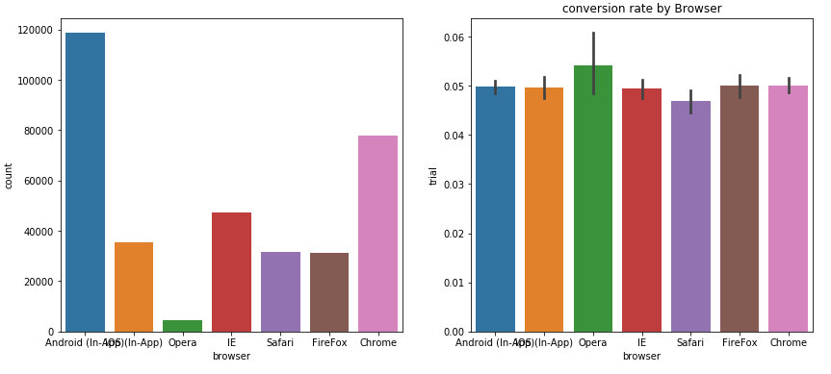
Conversion rate by Browser: Here users on browser “Opera” are minimum still results in highest conversion rate. On the other hand maximum no of users are using “Andriod (In-App) but conversion rate is similar to other browsers. We should investigate further why Andriod users are not converting as much as other users.

Slide 35
Actionable Insights
Marketing channel (Source) “Email” yielded highest conversion rate
Marketing channel (Source)“Facebook/LinkedIn” have more users but yielded lower conversion rates
Device “Mobile” yielded highest conversion rate
Device “Desktop” have more users but yielded lower conversion rates
Browser “Opera” yielded highest conversion rate
Browser “Android (In-App)” have maximum users but yielded lower conversion rates

Slide 36
Actionable Insights
Industry “SPC” yielded highest conversion rate for old video
Industry “SPC” did NOT see new video – This could drastically improve test users conversion rate
Industry “MFG” have maximum users but yielded lower conversion rate
MFE industry users have worst conversion rate for both control/test users - perhaps change video to highlight features for MFE industry

